Slide 1


Montgomery County Crime Data Analysis
By: Aryan Patel, Campbell Durbin, Caleb Maine, Chandler Boyd, Maddie Sells

Slide 2
Dataset Overview
1
Comprehensive Source
2
Dataset Dimensions
3
Potential Applications
Public crime data from Montgomery County, Maryland, obtained via data.gov.
Contains 421,538 rows and 30 columns.
Crime trend analysis and pattern recognition​.
Covers temporal, spatial, and categorical data on crime incidents.
Resource allocation for law enforcement​.
Offers detailed insights for analysis and policy-making.
Urban planning and public safety improvements.
Notes:
The dataset comes from Montgomery County, Maryland, and was obtained from data.gov.
It provides highly detailed crime records that can be used for in-depth analysis and policy-making.
The dataset is extensive and contains 421,538 rows and 30 columns.
It covers a variety of data types, including temporal, spatial, and categorical (crime classifications, agencies, etc.)
As for the potential applications...
Crime Trend Analysis and Pattern Recognition: The data can be used to identify recurring crime patterns and trends over time.
Resource Allocation for Law Enforcement: Insights from the dataset can help law enforcement agencies optimize their patrols and resource deployments.
Urban Planning and Public Safety Improvements: The dataset can guide urban planners and policymakers in addressing crime hotspots and enhancing community safety measures.

Slide 3
Question 1
Which police districts experience the highest levels of crime, and what are the most prevalent crime types within those districts? Furthermore, at what times are these crimes most frequently committed, categorized by crime type?

Slide 4
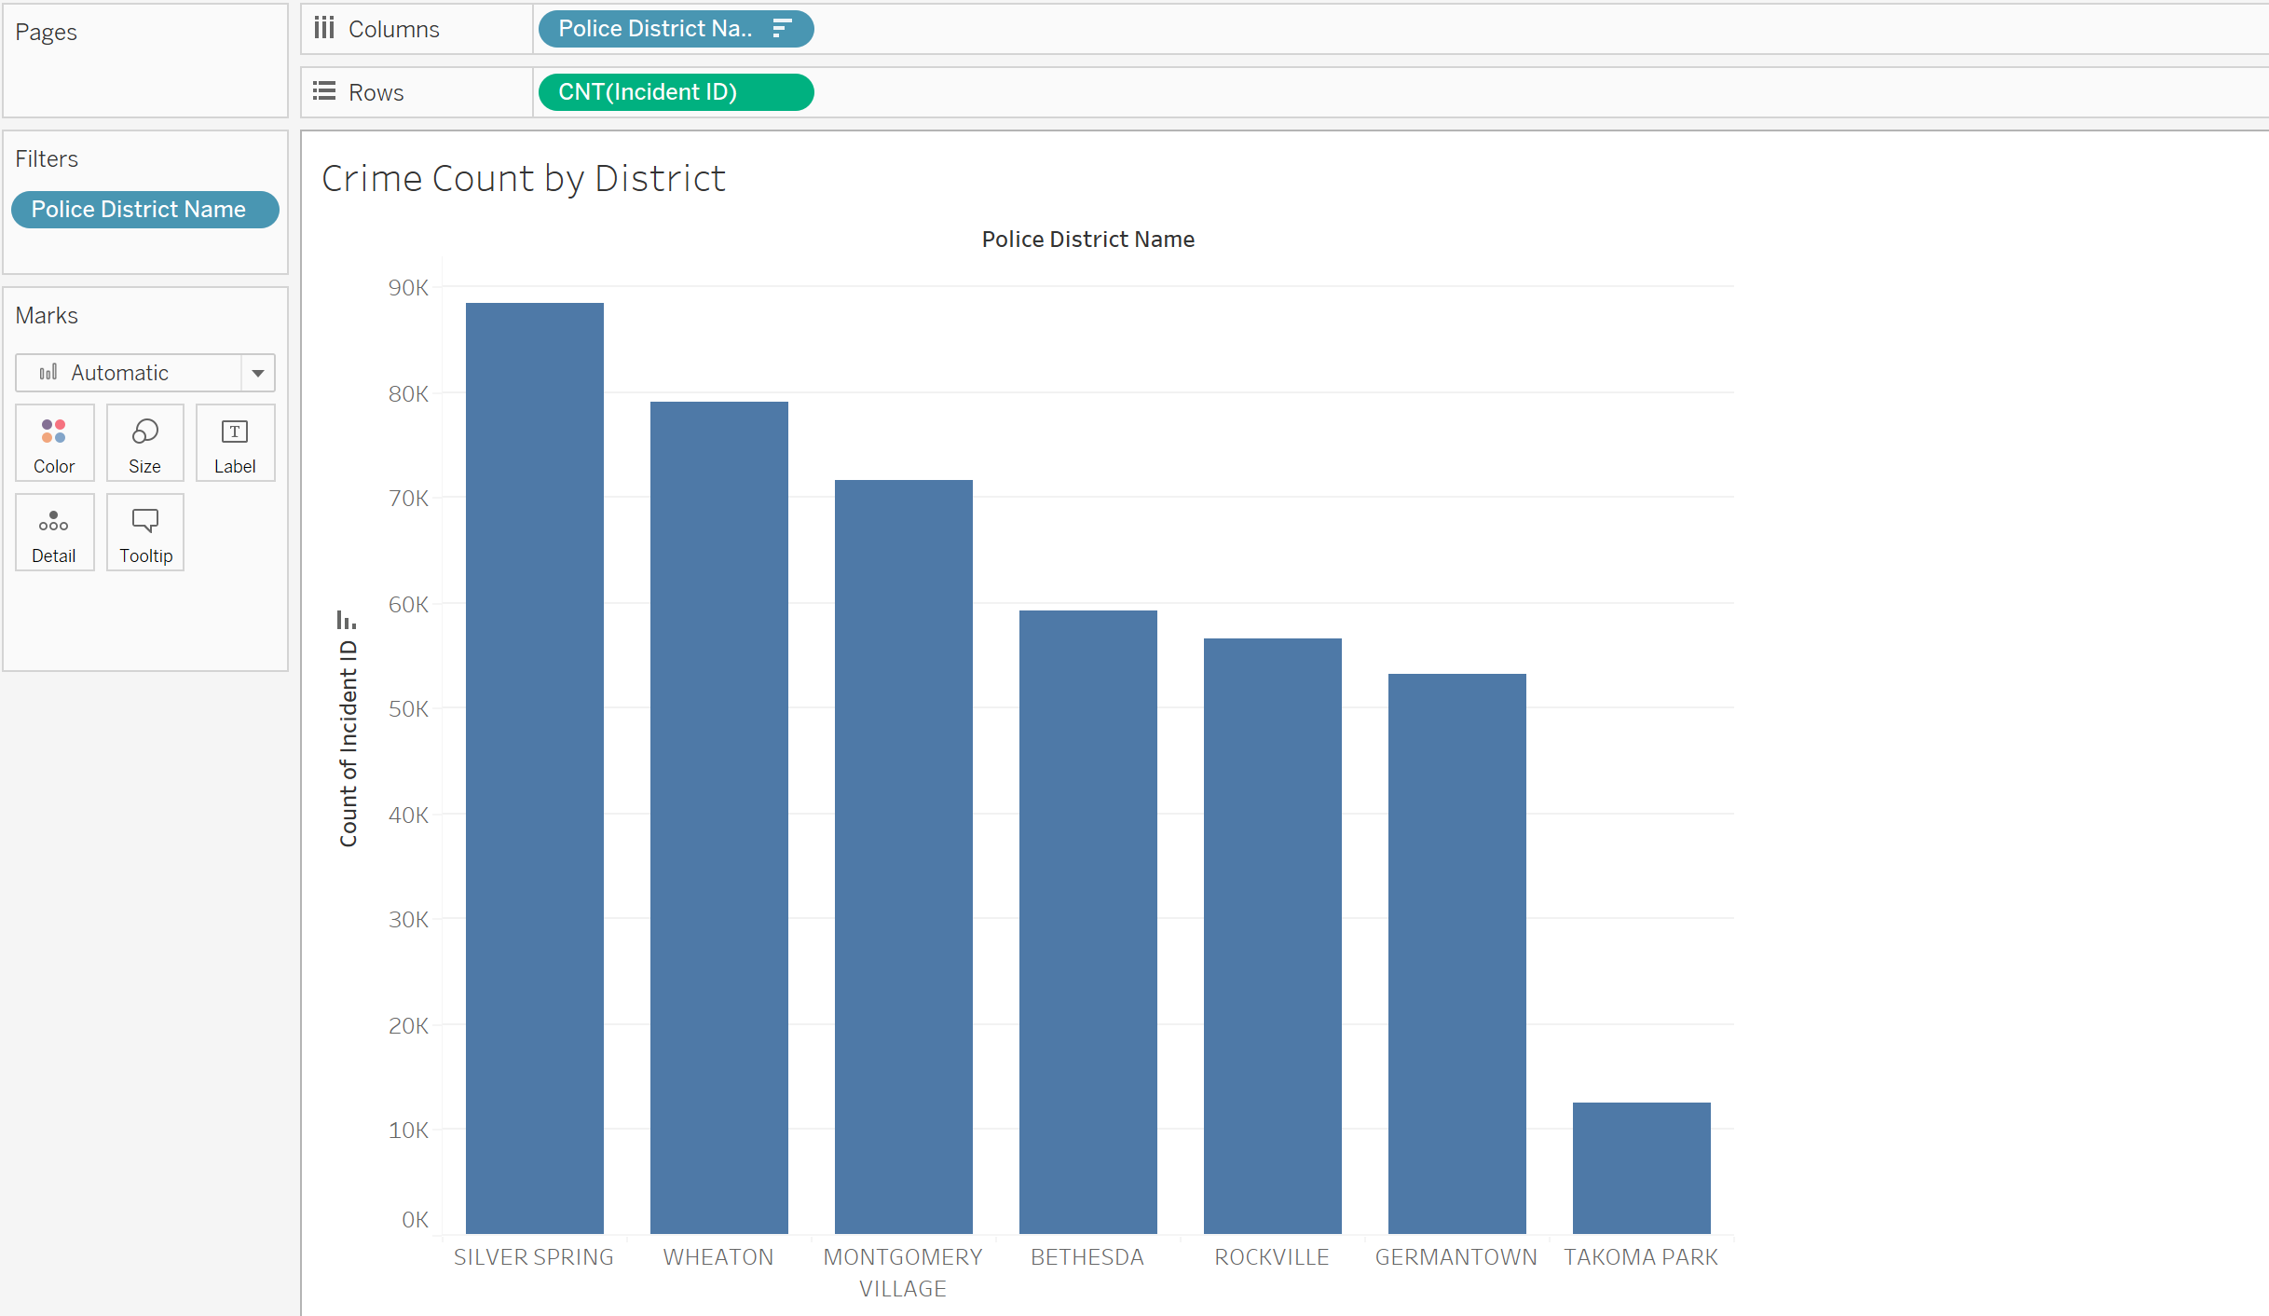
Crime Count by District

Slide 5
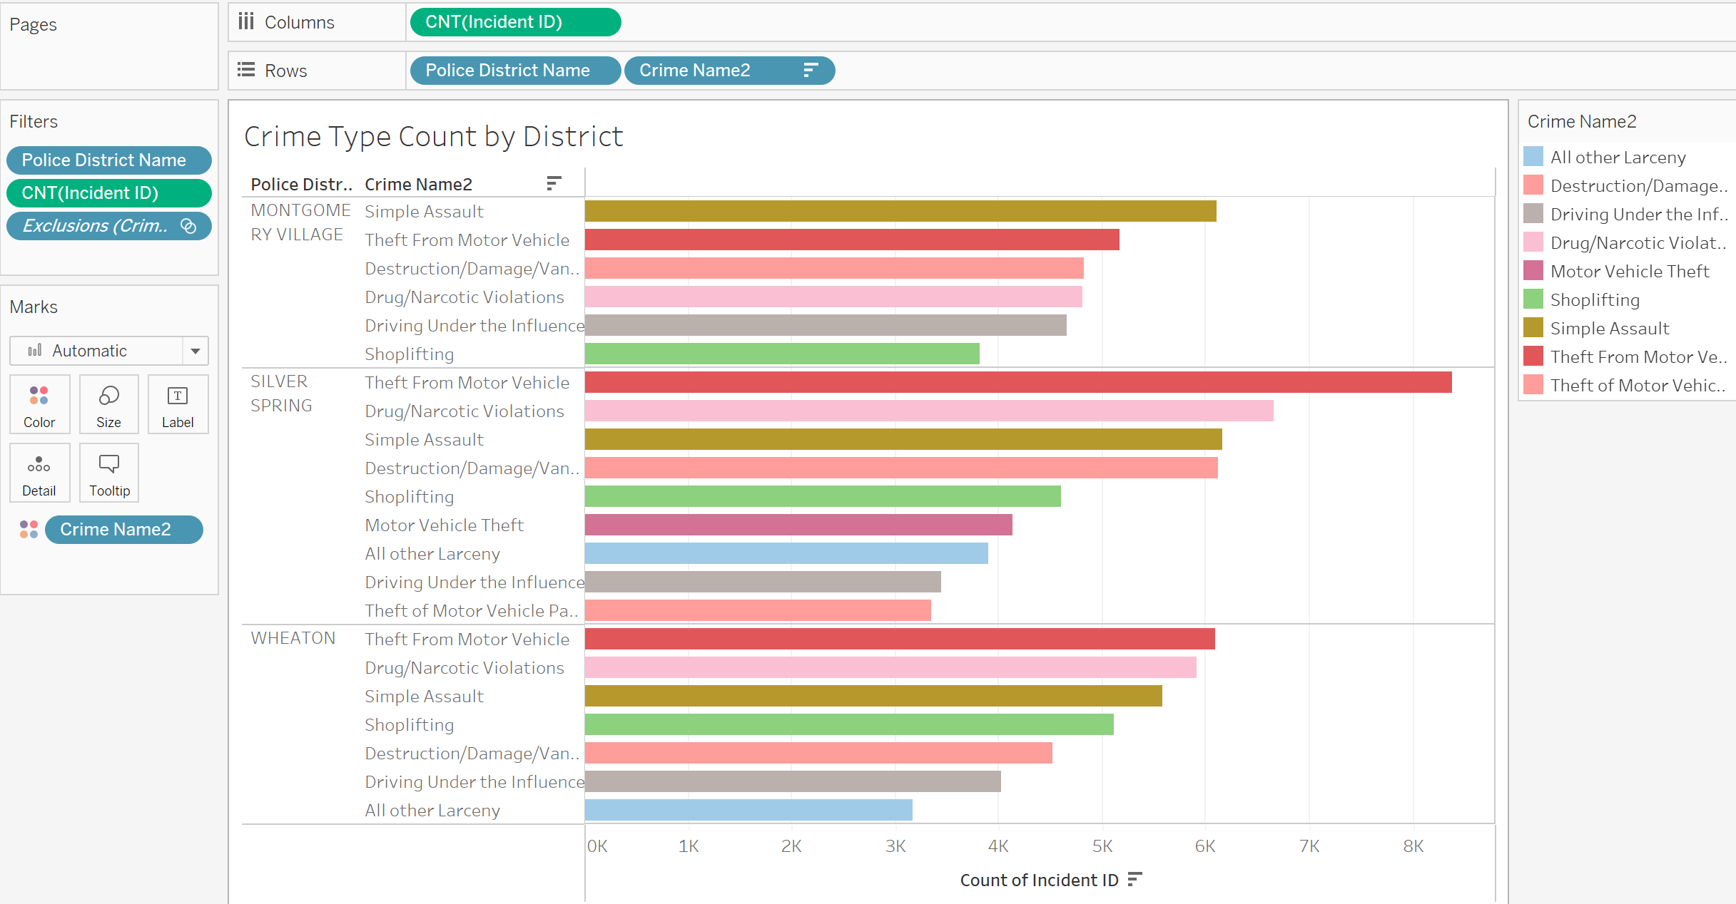
Crime Type Count by District

Slide 6
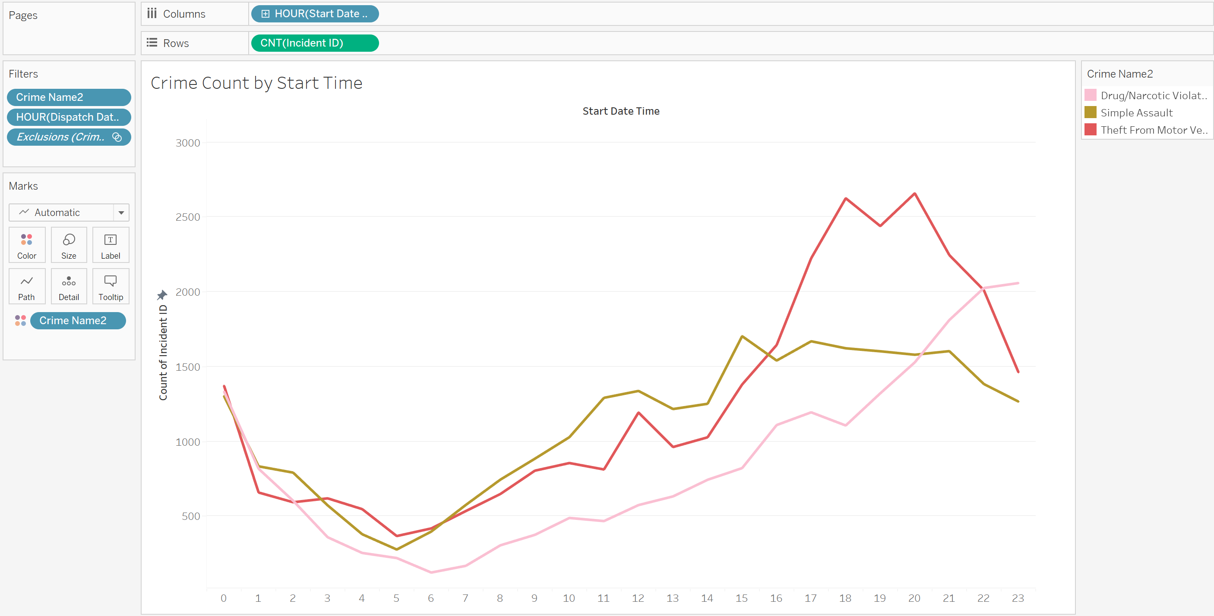
Start Time by Crime Type

Slide 7
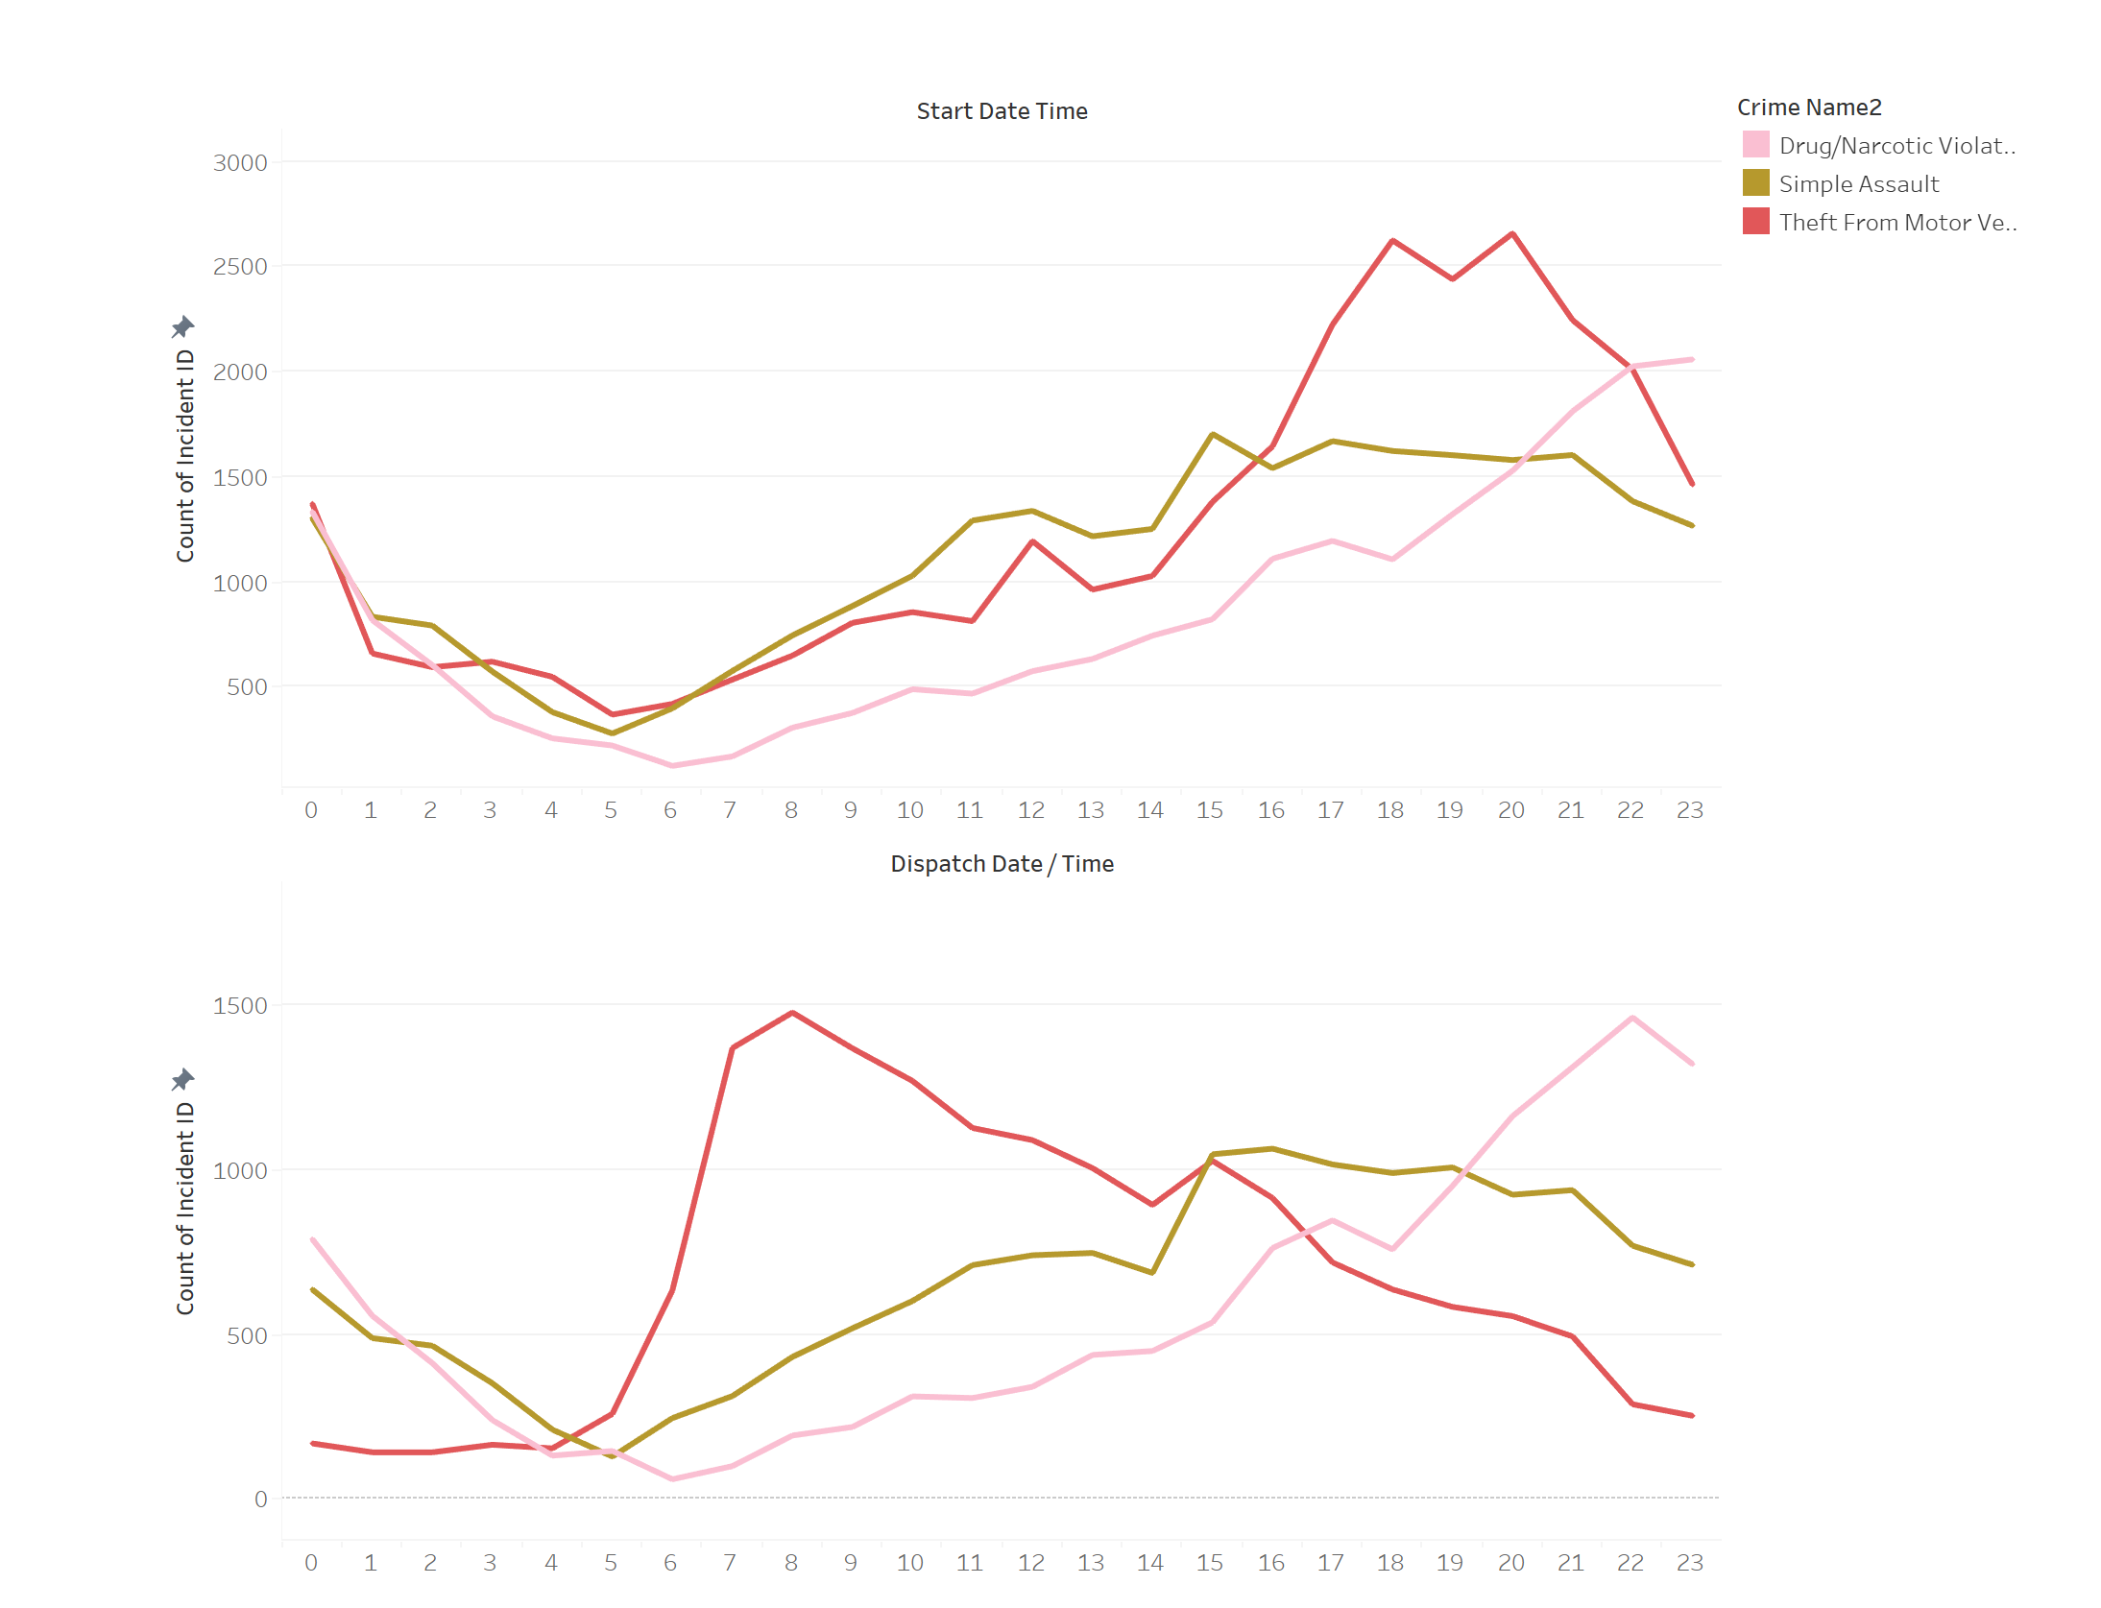
Start Time vs. Dispatch Time

Slide 8


Analysis and Importance
Identifying which districts experience the most crime, the most prevalent types of crime in those districts, and the times at which these crimes occur and require police dispatch allows authorities to effectively evaluate and deploy resources, including personnel and preventative measures like lighting and security cameras.

Slide 9
Question 2
Within each police agency, which beats are the most efficient responders? In other words, which beats have the quickest average response time?
Notes:
Beat- assigned police officer territory
Agency – municipality or county law enforcement

Slide 10
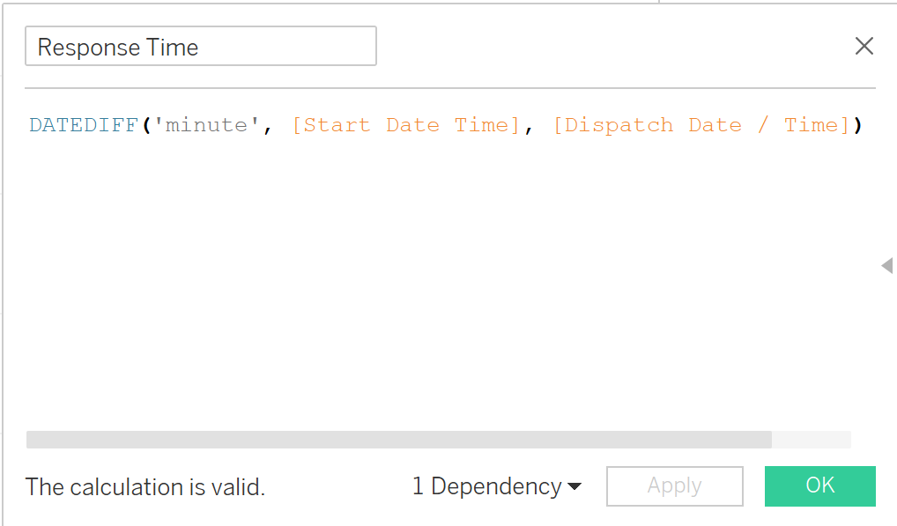
Calculated Field: Response Time
Notes:
Dates stored as MM/DD/YYYY and Time stored as HH:MM:SS
Dispatch Time - Start Time = Response Time

Slide 11
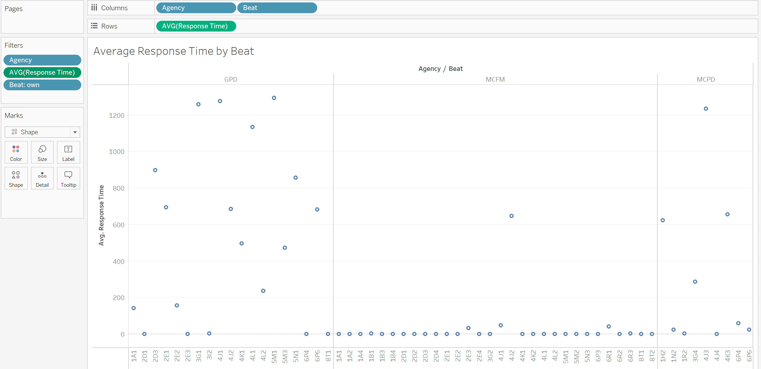
Average Response Time by Beat
Notes:
In minutes

Slide 12


Analysis and Importance
Identifying the beats with the shortest average response times is valuable for evaluating beat assignments, as deploying the most efficient beats in high-crime areas would maximize effectiveness.
Analyzing average response times further can uncover operational efficiencies and shed light on external factors influencing response times, such as traffic congestion or staffing challenges.

Slide 13
Manipulations
1
Excluded Null Data
And Outliers
2
Applied Filters
3
Created Calculated Field
Notes:
- excluding nulls for police district names, crime types, hours, agencies, and beats, and then excluding “all other offenses” for crime types in the second visualization because that didn’t provide much detail
- excluding the outliers for the beats because that would skew their averages
- for the beats visual, applied the filter to only be from 0-1440 minutes (24 hours) to narrow it down to the quickest beats
calculated field: Start Time is when the crime actually begins and the dispatch time is when the police units are actually sent to the scene, so the DATEDIFF is calculating the response time in minutes as Dispatch Time - Start Time

Slide 14
Questions?

